Slide 1
Basic Calculator Project
Developed by Vishwas Verma during an internship with Unified Mentor with HTML, CSS, JavaScript

Slide 2
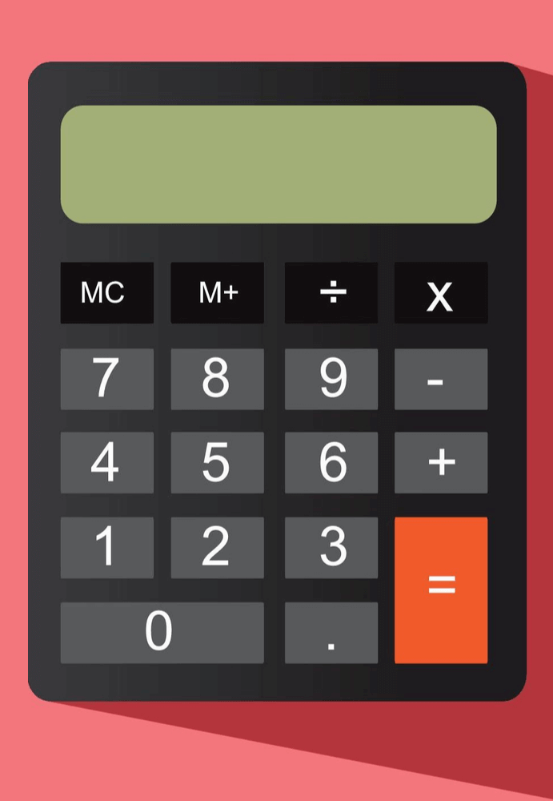
Introduction
This project is a basic calculator developed using HTML, CSS, and JavaScript. It allows users to perform basic mathematical operations such as addition, subtraction, multiplication, and division.

Slide 3
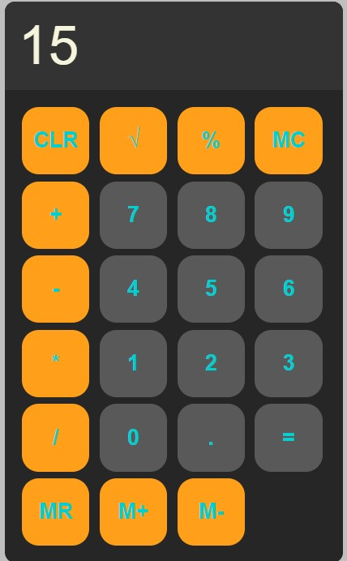
Features
1. User-friendly interface
2. Supports basic operations: +, -, *, /
3. Clear button to reset the display
4. Error handling for invalid operations
5. Responsive design

Slide 4

Tech Stack
1. HTML: For the structure of the calculator
2. CSS: For styling the calculator layout
3. JavaScript: For implementing the calculator's logic

Slide 5
Code Snippet - JavaScript
// JavaScript for Calculator Logic
function appendToDisplay(input){
display.value += input;
}
function clearDisplay(){
display.value = "";
}
function calculate(){
try{
display.value = eval(display.value);
}
catch(error){
display.value = "ERROR";
}
}

Slide 6
Input and Error Handling
Input Handling: - Handle user input via buttons and keyboard. Ensure accurate responses to user input.
Error Handling: - Implement error handling for cases like division by zero.

Slide 7

Extra Challenges (Optional)
Enhance the calculator by adding advanced features like square root, percentage calculations, or memory functions (M+, M-, MR, MC).

Slide 8
Demo
The calculator provides a simple interface to perform calculations. Users can input numbers and operators, then click the equals button to see the result. The clear button resets the display.

Slide 9
Assessment Criteria
The project was to be evaluated based on: - Functionality - User Interface Design - Code Quality - Error Handling - Additional Features (if included)

Slide 10
Code Enhancements
New Features and Enhancements Added:
Improved Error Handling: Prevents crashes on division by zero.
Advanced Operations: Added support for square root and percentage calculations.
Memory Functions: Added M+, M-, MC, MR for enhanced functionality.
UI Enhancements: Styled buttons with hover and active states using CSS.

Slide 11
Conclusion
This basic calculator is a great starting point for web development projects, demonstrating the integration of HTML, CSS, and JavaScript to create functional user interfaces.

